Slide 1
CO 4 SOCIAL MEDIA LOCATION & SEARCH ENGINE ANALYTICS

Slide 2
LOCATION ANALYTICS OUTLINE
Sources of Location Data
Categories of Location Analytics
Privacy Concerns
Location Analytics Tools

Slide 3
SEARCH ENGINE ANALYTICS OUTLINE
Types of Search Engines
Search Engine Analytics
Search Engine Analytics Tools

Slide 4
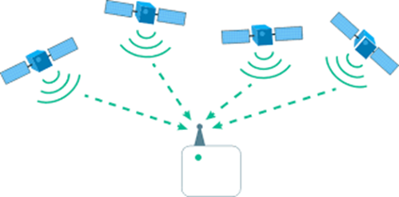
Sources of Location Data
Postal Address
Latitude Longitude
GPS-based
IP-based

Slide 5
Location Analytics
Location analytics, also known as spatial analysis or geo-analytics, involves mapping, visualizing, and mining the location of people, data, and other resources.
GPS-enabled mobile devices make it possible to provide location-based services, products, and information.
Location analytics can be used in various sectors and can be instrumental in understanding cities and human behaviors in space and time.
An example of location analytics is the use of geo-located Twitter data to study of New York City (França, Sayama et al. 2015) the "heartbeat" dataset of a city and map its dynamics.

Slide 6
Categories of Location Analytics
Based on its scope, location analytics can be broadly classified into two categories:
1) Business data-driven location analytics
2) Social media data- driven location analytics.

Slide 7
Business Driven Location Analytics
Business data-driven location analytics involves mapping, visualizing, and mining location data to reveal patterns and trends in business data.
By capitalizing on data stored in a business database, location analytics can provide location-specific information, products, and services based on where customers are.
Examples of how this can be used, include recommending the nearest convenient store or taxi, or making decisions about the best potential location for a business warehouse.

Slide 8
Revision
What is Location Analytics?
Sources of Location Data-4
Categories of Location Analytics -2

Slide 9
Applications of Business Data Driven Location Analytics
Powerful Intelligence
Simple maps can be useful,
sophisticated mapping techniques like
Clustering,
Heat mapping,
Data aggregation
Color-coded mapping can provide more detailed and insightful business intelligence.
Geo Enrichment
Simple data maps can be enhanced with customer information such as demographics, spending habits, lifestyle, and location.
This can help to answer questions such as where a company's loyal customers spend most of their time.

Slide 10
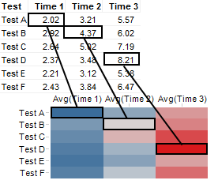
Example of a Heat Map

Slide 11
Popular HeatMap Softwares
Hotjar.
VWO.
Mouseflow.
Smartlook.
Plerdy.
Lucky Orange.
Heatmapper.
Glassbox.

Slide 12
Applications
Collaboration and Sharing
Maps are easy to understand and are useful for communication and collaboration within an organization.
Location analytics can be used to map business data for collaboration and information sharing with customers.
Business data -Google Fusion Tables, allows for the creation of maps, tables, and charts.

Slide 13
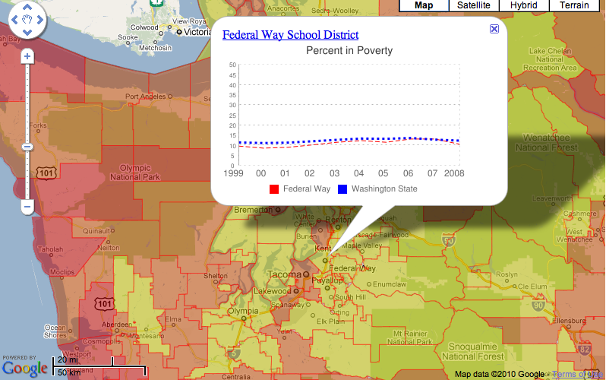
Google-Fusion Tables

Slide 14
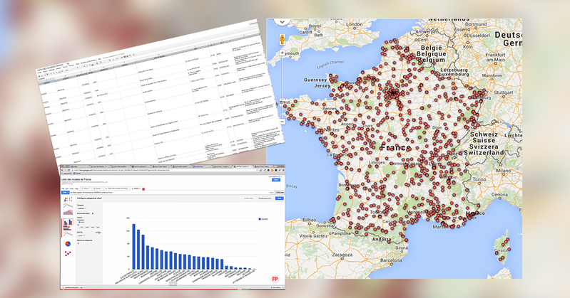
Google-Fusion Tables

Slide 15
Social Media Data Driven Location Analytics
Recommendation Purposes
Customer Segmentation -Tweepsmap (https://tweepsmap.com/), can be used to geo-locate your Twitter followers by country, state or city.
Advertisement-Location-based advertisement allows targeted marketing and promotion campaign mostly delivered through mobile devices to reach specific target audiences.
Information Request- Based on their current location, customers can request a product, service, or resource (e.g., the nearest coffee shop, restaurant, or parking lot).
Alerts - Location data can be used to send and receive alerts and notifications, such as sales and promotion alerts traffic congestion alerts, speed limit warnings, and storm warnings etc.
Search and Rescue - Location data is vital in search and rescue operations e.g. disaster management.
Navigation - Mobile and GPS-based navigation services and apps can help users find addresses. An example of this is the BE-ON-ROAD app for Android devices, which offers offline turn-by-turn GPS navigation.

Slide 16
Privacy Concerns
Location-based services can bring convenience and value to businesses, but they also raise privacy concerns.
These concerns include the need for transparency about location tracking, user control over the storage of location information, and options for preserving anonymity.
There are also questions about legal protection for historical location data against unreasonable searches, and the appropriate level of disclosure control.
There is a need for appropriate governmental regulation to protect citizens' privacy rights in the era of location-aware mobile devices.

Slide 17
Location Analytics Tools
Google Fusion Tables- is a web service for geo-tagging, storing, sharing, querying, and visualizing tabular business data on Google Maps.
Agos- is a platform for geo-tagging and reporting that helps communities address climate change and disaster risk reduction. http://agos.rappler.com/#
Tweepsmap- maps Twitter followers by location. https://tweepsmap.com/
Trendsmap- is a real-time tool that maps the latest trends from Twitter. http://trendsmap.com/
Followerwonk- is a tool for performing basic Twitter analytics such as analyzing followers, location, and tweeting patterns. http://followerwonk.com/
Esri's GIS software is used for mapping, visualizing, questioning, analyzing, and interpreting data to understand relationships, patterns, and trends. http://www.esri.com/

Slide 18
Questions
Define location analytics.
Explain the two main categories of location analytics.
What are the sources of location data.
What are the main applications of business data-driven location analytics?
What are the main applications of social media data-driven location analytics?
Discuss privacy concerns related to location analytics.
List out and brief Location Analytics Tools .

Slide 19
Search Engines
Search engines are tools that help users find information on the internet. They do this by searching for information that corresponds to a user's request (e.g., keywords).
There are billions of websites on the internet, so search engines are crucial for helping users find the right information quickly.
There are different types of search engines.

Slide 20
Types of Search Engine
1) Crawler-based,
2) Directories
3) Metasearch engines.

Slide 21
Crawler based Search Engine
Crawler-based search engines create their databases or lists automatically, without any human intervention.
E.g. google, bing
Web crawling involves collecting and storing information about web pages
Indexing involves categorizing and storing this data in a database for quick access
Searching involves using keywords to query the index and provide a list of relevant web pages ranked according to various factors

Slide 22
Directories
Directory listings are compiled and created by human editors
Website owners can submit their website for inclusion in the directory
The submission is reviewed by the editor before being added to the directory
Some examples of human-created directories include Yahoo Directory, Open Directory, and LookSmart.

Slide 23
Meta Search
Metasearch engines compile and display results from multiple individual search engines . e.g. Metacrawler,Mamma, and Dogpile
Local search engines are embedded within a specific website and only search the content of that website
Global search engines search the entire web and can be localized to specific websites
Examples of global search engines include Google and Bing

Slide 24
Search Engine Analytics
Search engine analytics involves analyzing and interpreting data from search engines
It helps website owners understand and improve their website's performance in search results
It can involve analyzing various data points such as the number of visitors, keywords used, pages visited, and website position in search results
Search engine analytics can be used to track the effectiveness of SEO efforts and guide future SEO strategies
There are two types of Search Engine Analytics
1) Search engine optimization
2) Search engine trend analysis.

Slide 25
Search Engine Optimization
Search engine optimization (SEO) is the process of improving a website's ranking on a search engine results page (SERP).
SERPs have both organic and nonorganic results, with organic results being based on relevance to the user's query and nonorganic results being paid advertisements
It is important for websites, especially commercial ones, to have a high ranking on SERPs because it can lead to more traffic and potential customers
The main factor that determines a website's ranking on a SERP is its PageRank, which is determined by the quality and number of incoming links to the website
Tools like Open SEO Stats can be used to check a website's PageRank and other relevant information such as traffic, hyperlink status, and page speed.

Slide 26
Search Trends Analysis
How people search for your brand?
When does interest spike in your products or services?
Which keywords drive more traffic?
Which regions are interested in your brand?
What are trending topics over the Internet?
How are your competitors performing?

Slide 27
Search Trends Analysis
Search engine trend analytics involves analyzing and understanding the keywords used in search engines.
Google Trends is a comprehensive tool for analyzing search engine trends and predicting future trends.
It can be used to understand how people search for a particular brand, when interest in products or services spikes, which keywords drive the most traffic, and how a brand's competitors are performing.
Google Trends data has also been used in various industries to detect early warning signs and track flu epidemics.
From a business perspective, Google Trends can help answer questions about search trends and patterns related to a brand.
http://www.google.com/trends/

Slide 28
Search Engine Analytics Tools
Google Trends is a search engine analytics tool
Canopy is a multimedia analytics tool for deep investigation of large multimedia collections
Google Alerts is a content detection and notification service that alerts users when new content matching their search terms is found on the internet
Icerocket is a tool that specializes in blog searches and also captures activity on social media platforms
Social Mention is a tool similar to Google Alerts but focused on social media sites and allows users to focus on particular areas such as blogs
TweetBeep is a tool that allows users to receive daily search results via email for specific keywords on Twitter.

Slide 29
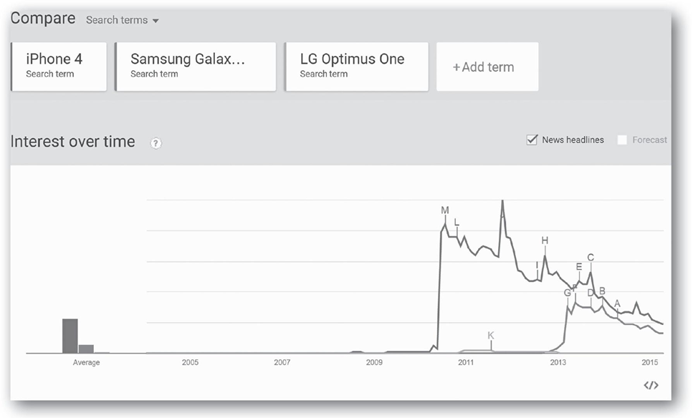
Google Trends

Slide 30
Type of Analytics Provided by Google Trends
Year in Search
Trending Searches
Trending on YouTube
Top Charts
Explore
Subscription

Slide 31
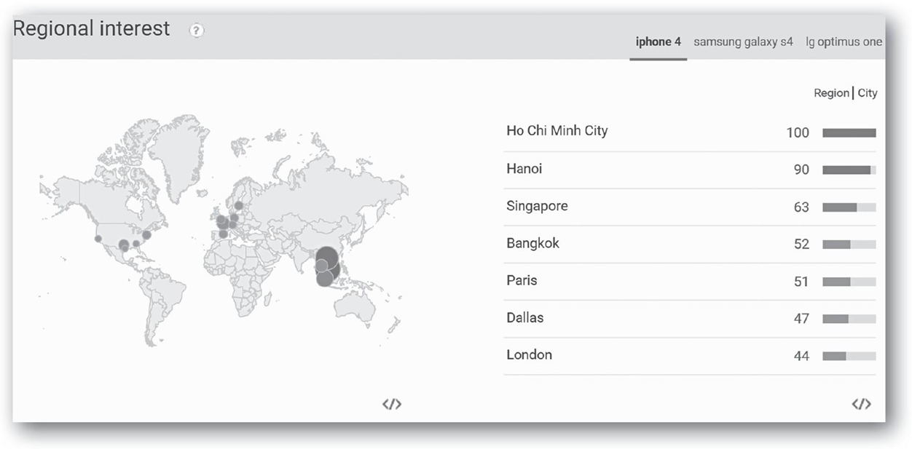
Regional Interest

Slide 32
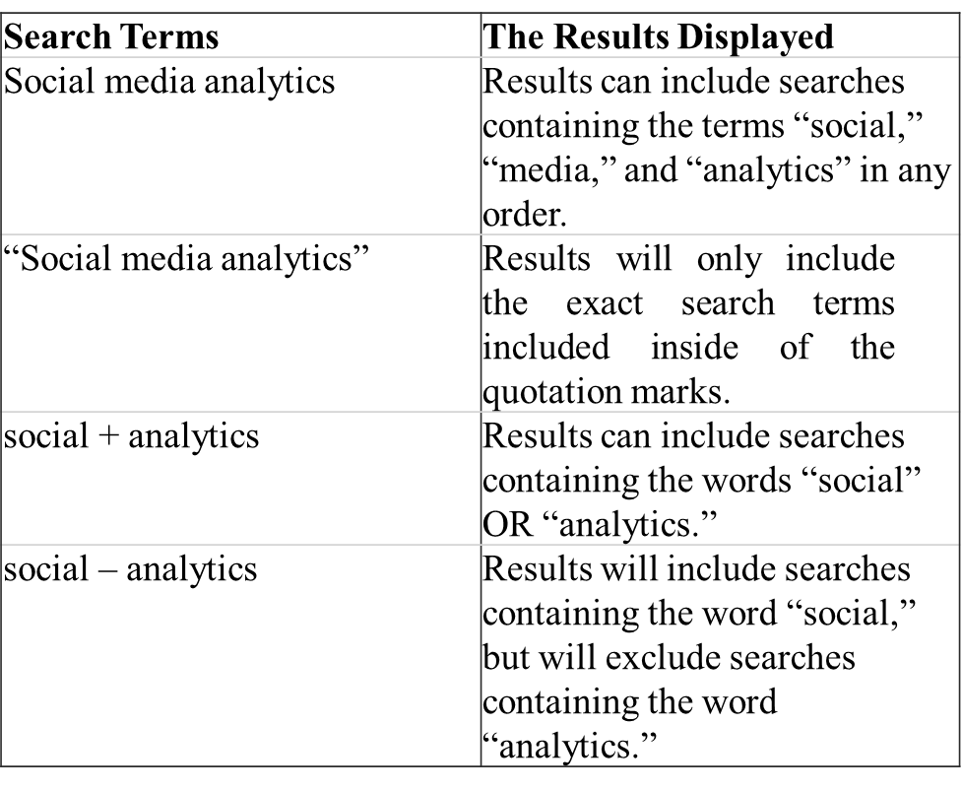
Understanding the Research Function

Slide 33
Grouping Search Term
Grouping Search Terms
Overall, you can search up to five groupings at one time, with up to twenty-five search terms in each grouping. Consider the following example.
iPhone 2 + Galaxy S2 + LG G (Grouping 1)
iPhone 3 + Galaxy S3 + LG Optimus F3 (Grouping 2)
iPhone 4 + Galaxy S4 (Grouping 3)
iPhone 5 + Galaxy S5 + LG Optimus F6 (Grouping 4)
iPhone 6+ Galaxy S6 (Grouping 5)

Slide 34
Customizing the Search
Google Trends allows users to customize search results by country, year, category, and type of web resource
Users can also select custom data ranges from the date dropdown menu
Trend data is only available from 2004 onwards.

Slide 35
Wolfram Alpha
Wolfram Alpha is a computational knowledge search engine which does not give list of documents or web pages as search results.
Results are based on facts & data about that query.
Their mission statement is to make all systematic knowledge computable and broadly accessible.
Launched in 2009, having a Pro solution designed with pricing for Students and Educators.

Slide 36
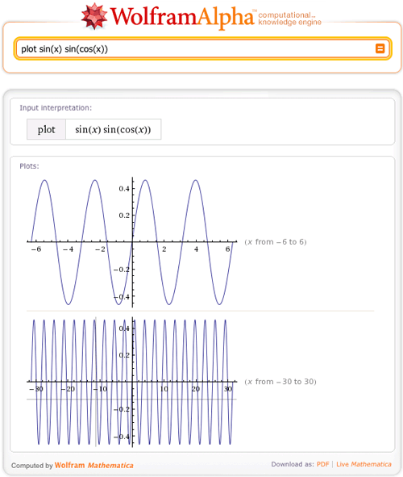
Wolfram Alpha Plotting

Slide 37
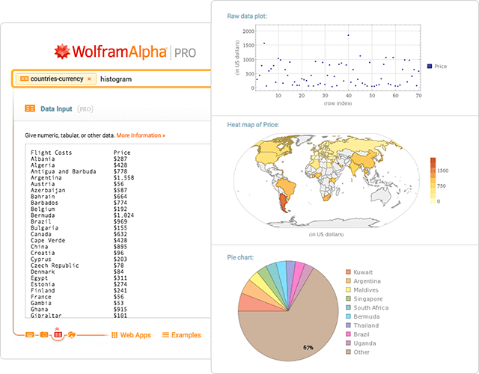
Wolfram Alpha Plotting

Slide 38
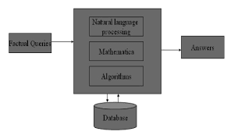
Schematic of Wolfram Alpha Working

Slide 39
Questions
What is the function of a search engine?
Explain different types of search engines.
Differentiate between local and global search engines.
What is search engine analytics?
Explain the two main categories of search engine analytics.
What is the purpose of search engine optimization?
What is the purpose of search engine trend analysis?

Slide 40

Supportive Case Study
Re-wiring the Brain is possible.
Identify the Success Blockers.
Natural Competency to adopt new environment.
Fool your brain.
Continuous bombardment is absorbed by Subconscious mind.
Dr. Meghana Dixit

Slide 41
Steps in Location Analytics
1. Plot Stored Locations on a map.
2. Identify and plot your Competitors.
3. Plot your current customers
(by zip code or address)
4. Take actionable conclusions.

Slide 42
Steps in SEO (Search Engine Optimization)
Step 1: Find keywords.
Step 2: Put keywords in the page title.
Step 3: Put keywords in the page URL.
Step 4: Put keywords in meta description.
Step 5: Put keywords in heading.
Step 6: Use keywords in the page's content.
Step 7: Build links to your website.
Step 8: Monitor your rank.

Slide 43
Components in SEO
Keyword Search
Identify the terms for search
4 Core Components
Social Media
Site Speed
Off-page SEO
On-page SEO
Link Building
Meta Data
Local
SEO
Directory Submission

Slide 44
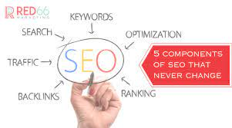
SEO Components

Slide 45
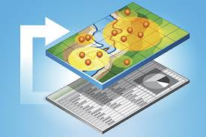
Working of Agos Tool

Slide 46
FollowerWonk
Follower wonk allows insights into Twitter data.
users can identify brand influencers, widen reach, breakdown followers using social authority and enhance follower engagement.
Keywords can be used to search Twitter users and compared against metrics such as reach, influence, age.

Slide 47
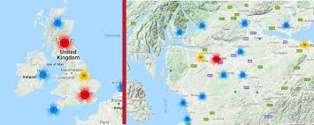
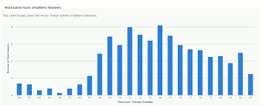
Working of FollowerWonk
Identification of Network Density
Statistical Plotting

Slide 48
Trendsmap
Trendsmap is a Twitter trend tracking service that sticks tweets onto an interactive map.
It then sticks it onto a Google Map where users can sort by city or general region and see trending topics in real-time.
It offers real-time geographic visualization for emerging Twitter trends.
Trendsmap allows visitors to view the most often used words in current Twitter posts from a global perspective.

Slide 49
Search Engine Analytic Tools
Canopy
IceRocket

Slide 50
Canopy
Canopy collects and controls data from IoT and connected devices using a single control plane.
Data is aggregated, unified, visible and usable.

Slide 51
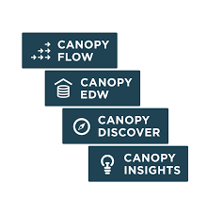
Working of Canopy Tool

Slide 52
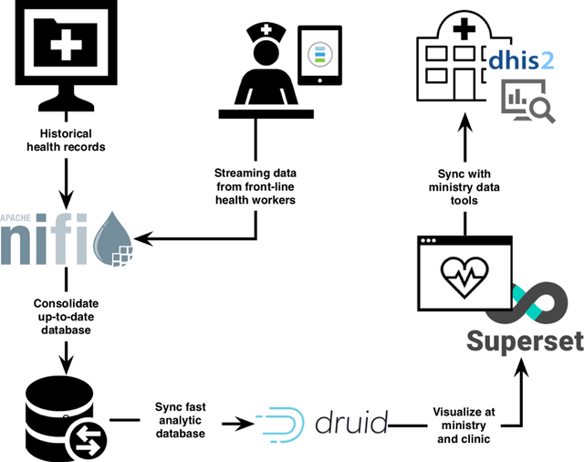
Canopy EDW

Slide 53
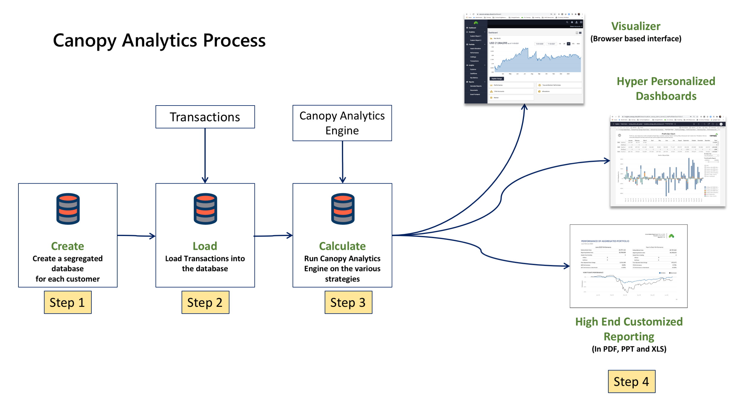
Canopy Working Schematic

Slide 54

IceRocket SEA Tool

Slide 55
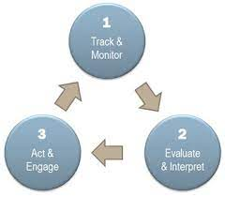
Online Reputation Management

Slide 56

TweetBeep
Using Tweet beep you can get all such updates (known as TweetBeep alerts or Twitter alerts) to email every hour of the day.
Also, we are even provided with information on people tweeting about you.
This information can be extracted even if the person is using a shortened URL (using tools like Tinyurl.com or bit.ly) to hide the identity your website or blog.

Slide 57
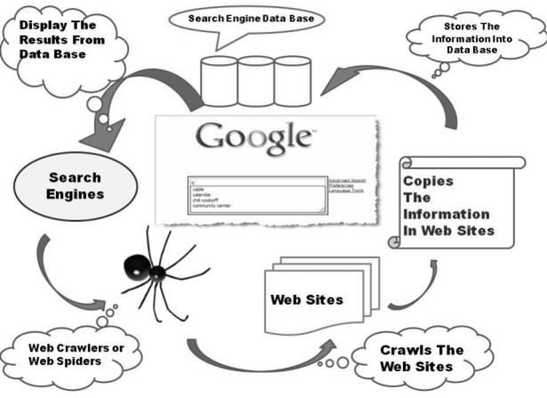
Search Engine Mapping

Slide 58
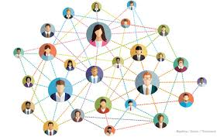
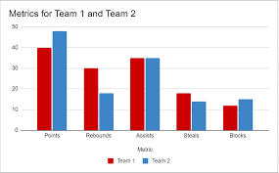
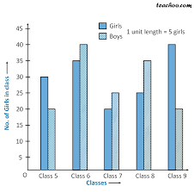
Dual Bar Graph

Slide 59
Querries????

